Slide 1
Graphical Models : Discrete Inference & Learning
Style Transfer using Graph Cuts
Antoine DEBOUCHAGE, Thomas LEMERCIER, Gaspard BERTHELIER
[1] Multimodal Style Transfer via Graph Cuts, Y. Zhan et al. (2020)

Slide 2
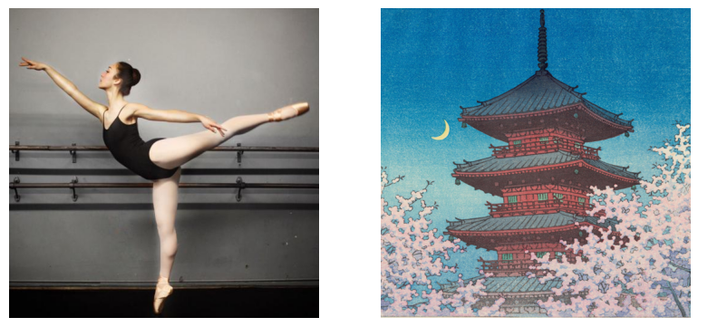
State of the art
content image
style image
Style transfer : applying the “style” (shape, color, texture) of a style image to a content image
Two families of methods :
Parametric : using the statistics of style image
Patch-based : matching and merging patch of pixels
Issues : artifacts, wash-out effect, errors
→ MST [1] : solves these issues and allows multimodality
multimodality : different styles applied to different locations in content image
[1]

Slide 3
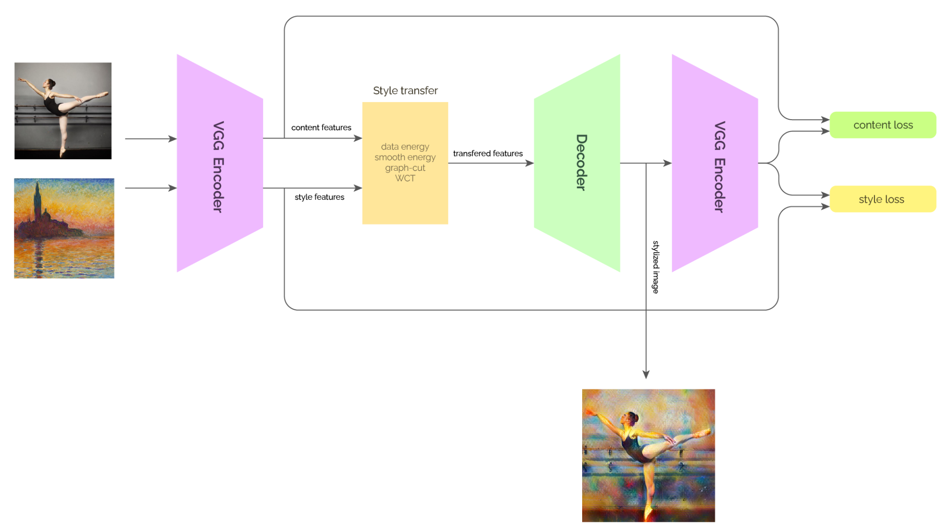
Pipeline
MST
Encoder: pretrained VGG truncated up to Conv4_1
Style matching : graph cuts (alpha expansion)
Style transfer: feature whitening and coloring
Decoder: to train (content & style losses = MSE)
[1], [4]

Slide 4
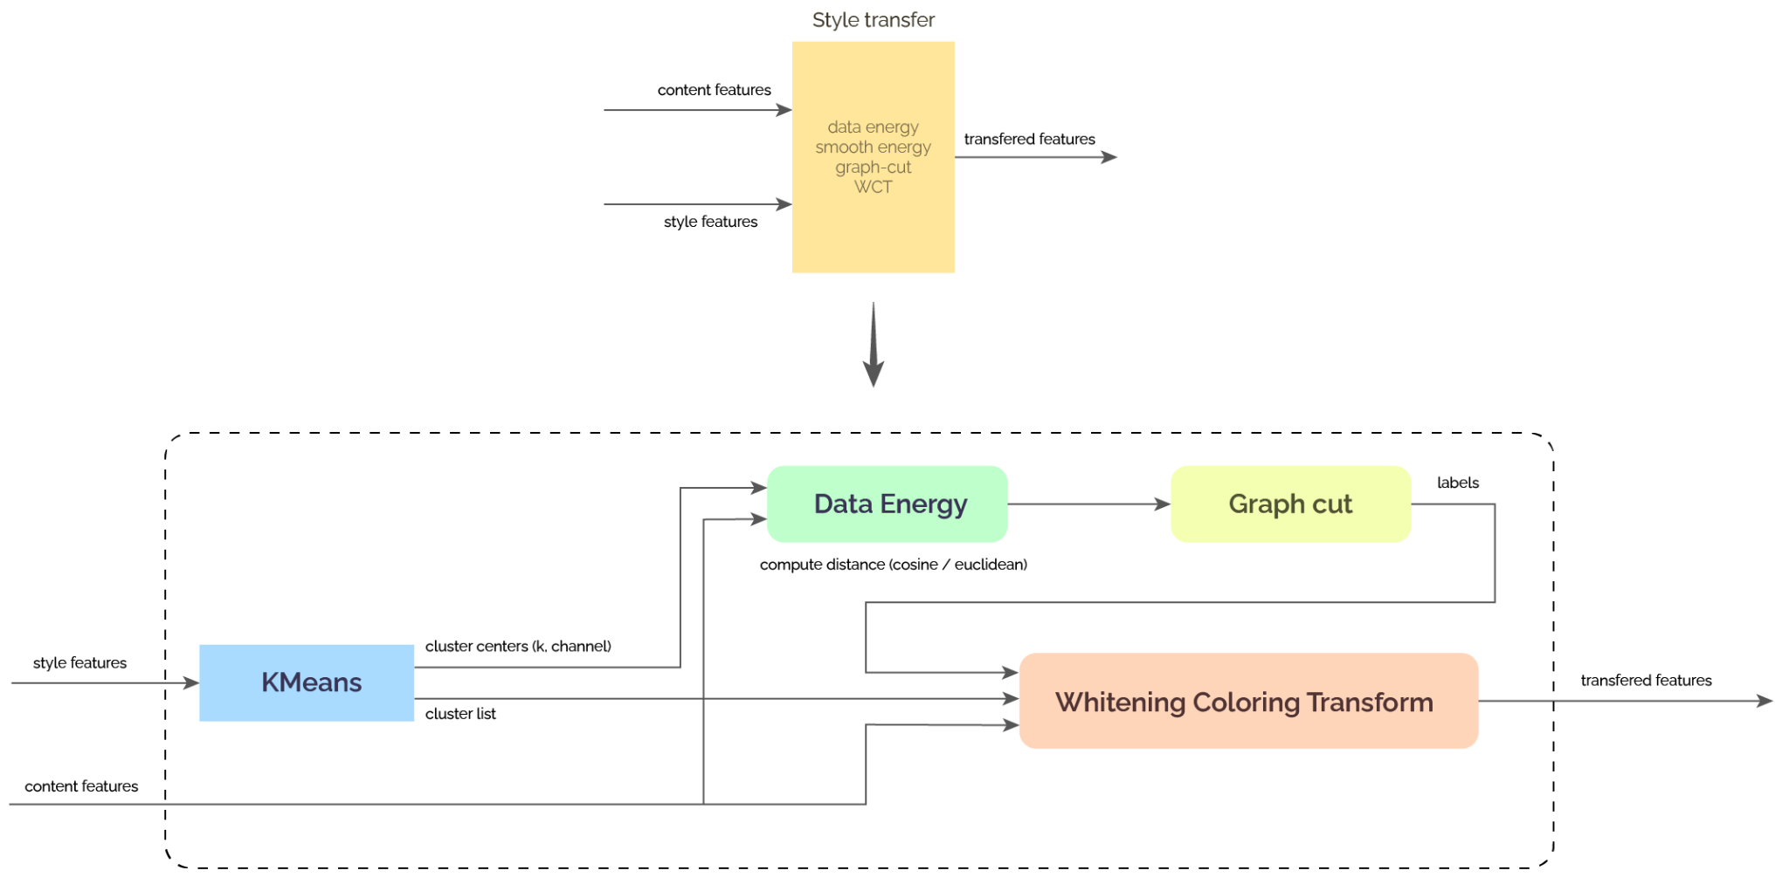
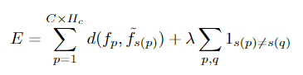
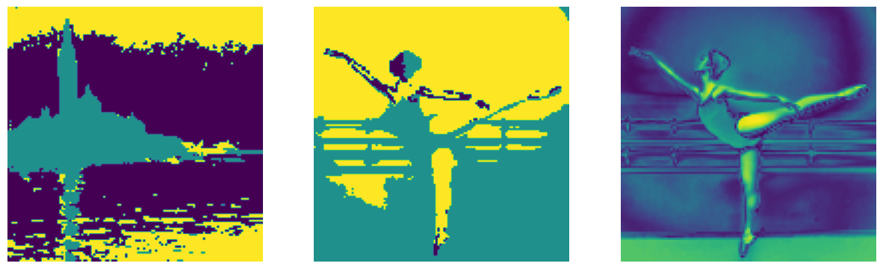

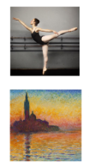
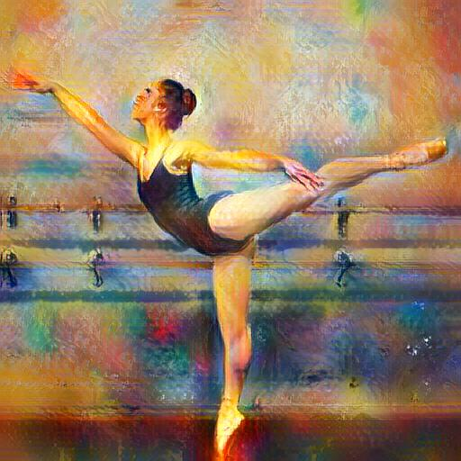
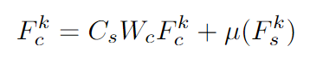
Pipeline
K-means for K style clusters
[1], [2], [3]

Slide 5
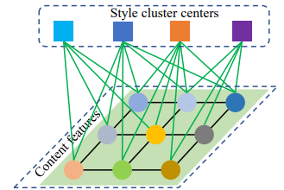
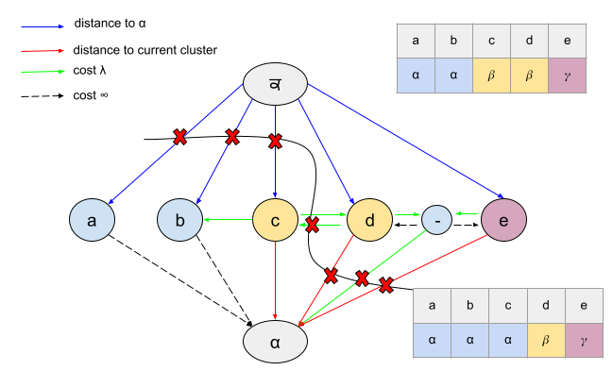
Alpha expansion
minimize energy function :
distance to cluster
smoothness term
Coding our own algorithm
Stochastic : assign random new cluster to random pixel
Greedy : assign cluster with smallest total energy to random pixel
Alpha expansion :
- choose a label α - create expansion graph - graph cut to select nodes to assign α
proven to decrease energy at each step → local minima (NP-hard problem) [3]
[3]

Slide 6
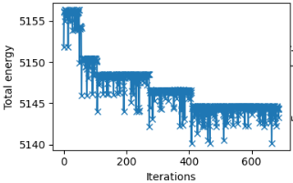
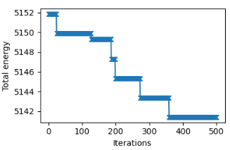
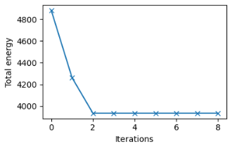


Alpha expansion
minimize energy function :
stochastic
greedy
alpha expansion
reached local minima
alpha expansion
choosing λ
λ = 0
λ = 0.01
λ = 0.1
λ = 1
[3]

Slide 7
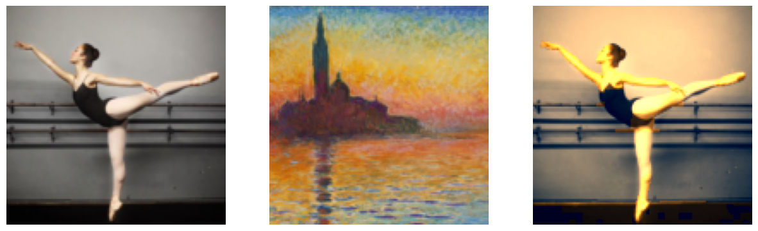
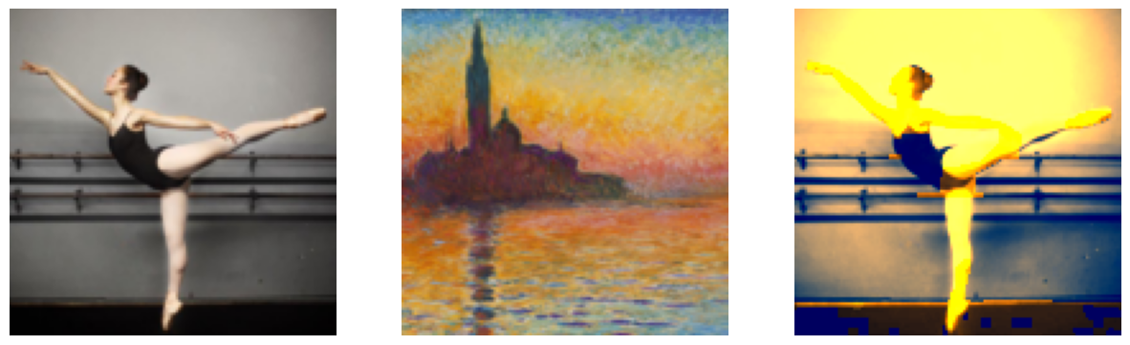
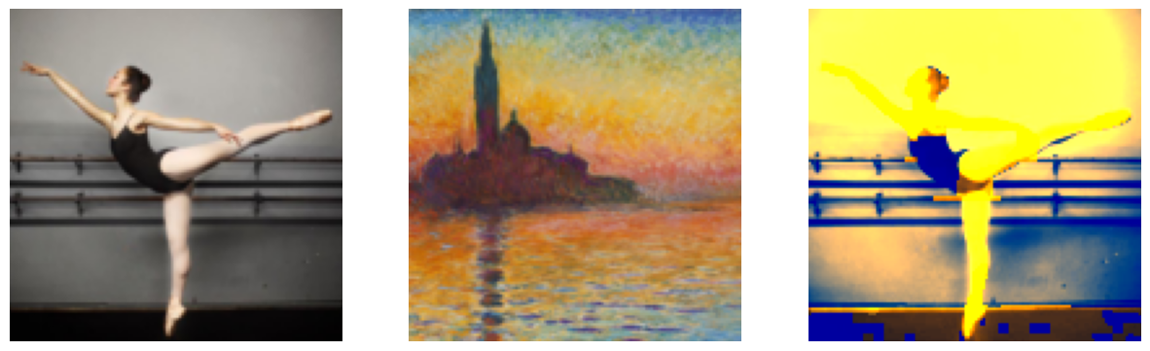
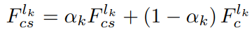
Our experiments
Style transfer of RGB images
alpha expansion with λ = 0.01
choosing α
α = 0.1
α = 0.3
α = 0.5
The RBG space is not the best feature space to extract style clusters
[2]

Slide 8
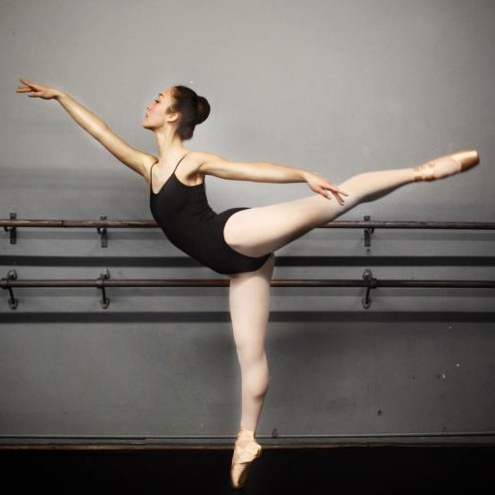
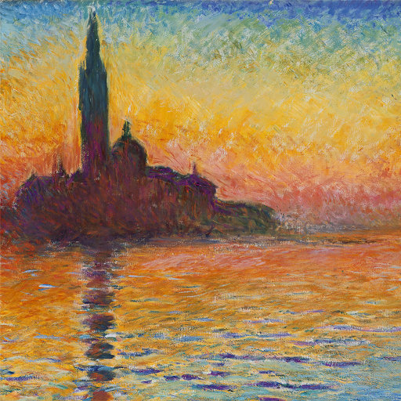
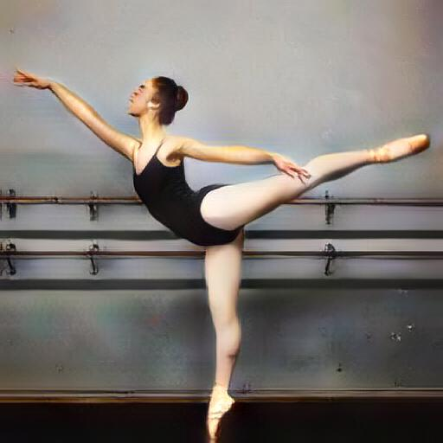
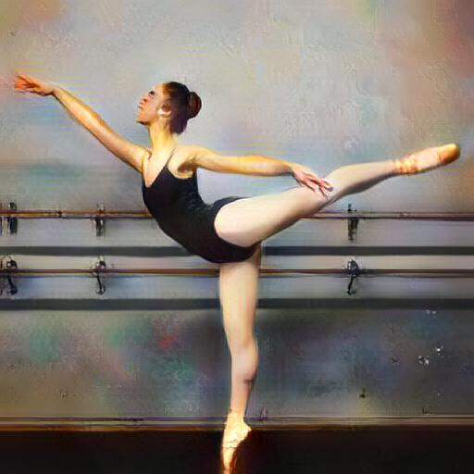
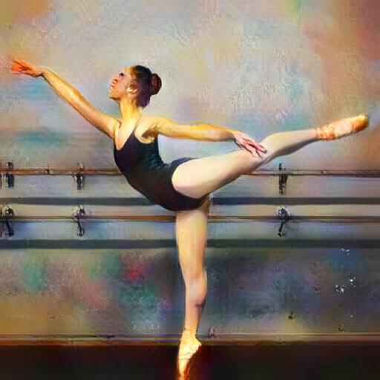
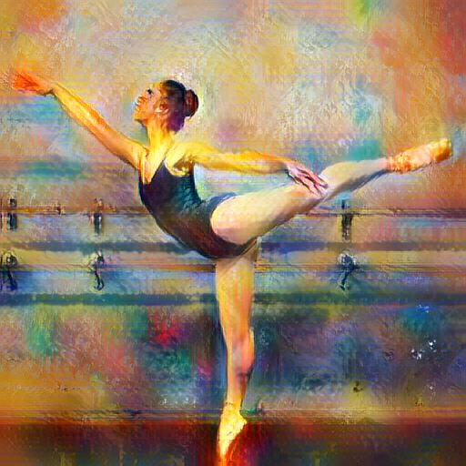
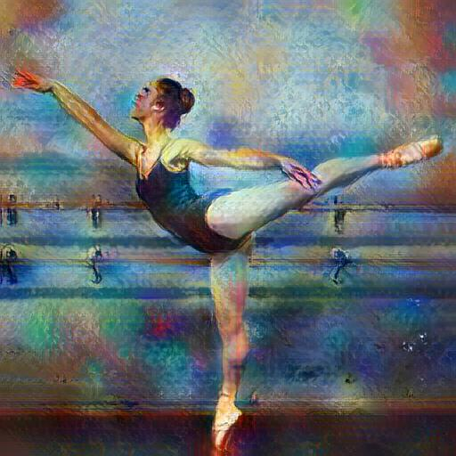





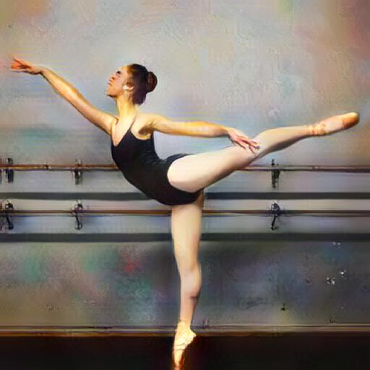
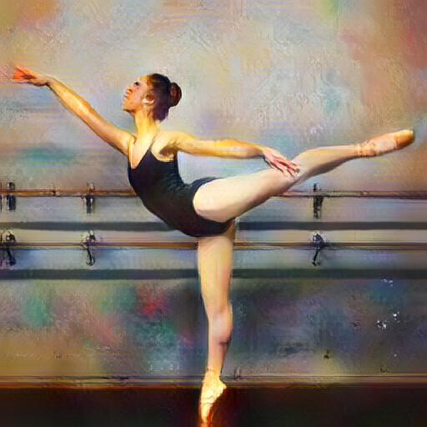
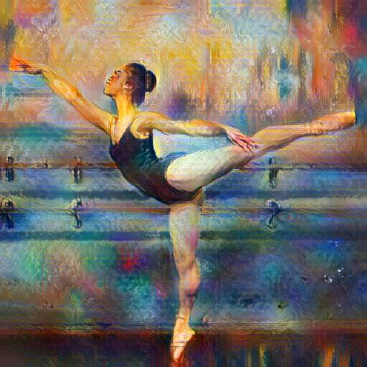
Exploring the hyperparameters (full model)
α = 0.1
α = 0.3
α = 0.5
α = 0.9
α = 0.9
β = 0.001
β = 0.01
3 clusters
5 clusters
β = 0.1
[1], [4]

Slide 9

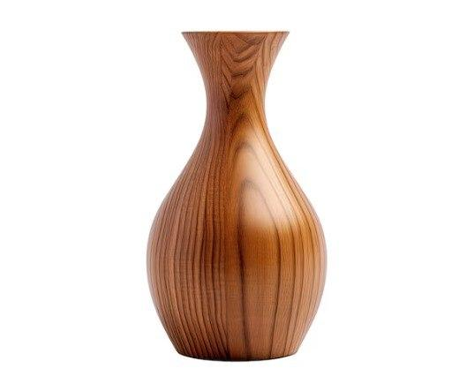

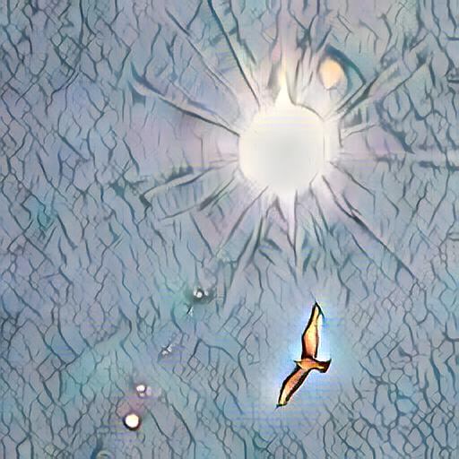
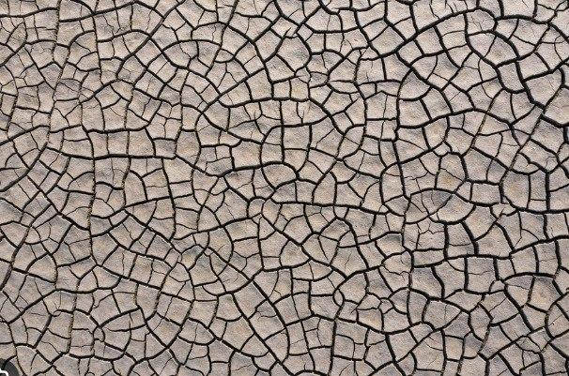
Results

Slide 10


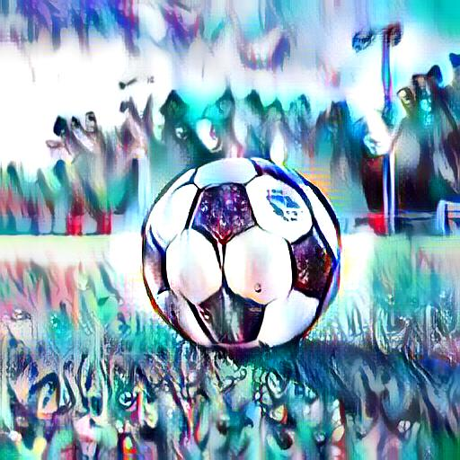
Results

Slide 11
Conclusion
Successively reimplemented the MST algorithm, as well as a study of :
alpha expansion algorithm
choice of feature space (RGB / VGG)
smoothness energy coefficient λ
weight of style transfer α
No artefacts and effective multimodality.
Many potential applications : data augmentation, digital art, photo filters (instagram, snapchat, …), interior design, …
Drawbacks : must choose α manually depending on context

Slide 12
Thank you for your attention
[1] Multimodal Style Transfer via Graph Cuts, Y. Zhang et al. (2020), https://arxiv.org/pdf/1904.04443.pdf
[2] Understanding Generalized Whitening and Coloring Transform for Universal Style Transfer, T. Chiu (2019), https://openaccess.thecvf.com/content_ICCV_2019/papers/Chiu_Understanding_Generalized_Whitening_and_Coloring_Transform_for_Universal_Style_Transfer_ICCV_2019_paper.pdf
[3] Generalized Fast Approximate Energy Minimization via Graph Cuts: Alpha-Expansion Beta-Shrink Moves, M. Schmidt et al. (2011), https://arxiv.org/abs/1108.5710
[4] Very Deep Convolutional Networks for Large-Scale Image Recognition, K. Simonyan et al. (2014), https://arxiv.org/abs/1409.1556

Slide 13
Appendix

Slide 14
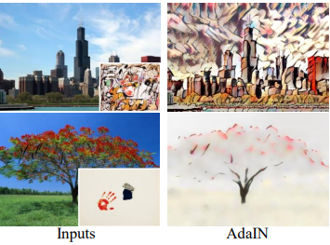
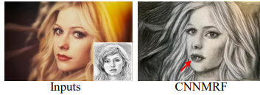
Problems of SOTA
distorsions
wash out
errors
[1], [2], [3], [4]

Slide 15
Proposed Method [1]
Feature extraction : convolutional network (layer Conv_4_1 of VGG-19) [4]
Extract style clusters : K-means for K style clusters
(content image pixels) ⇹ (style cluster centers) matching : using graph cuts, specifically alpha expansion [3]
Style transfer : feature whitening and coloring (WCT) [2]
Decoder : ~mirror of VGG, trained with loss on content and style
[1], [2], [3], [4]

Slide 16
Graphcut
Using networkx : Stoer-Wagner algorithm
recursively merges nodes pair by pair using having only two sets of nodes
we can also use shortest augmenting path algorithm to maximize flow (and thus find min-cut via the max-flow mint-cut theorem)
Using igraph : Stoer-Wagner algorithm
supposed to be faster but we did not observe a difference

Slide 17
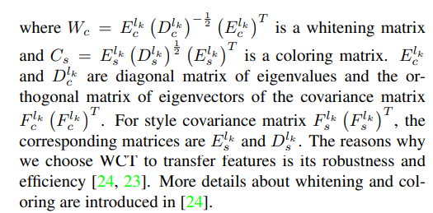
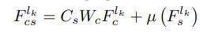
WCT
Whitening of the content image and coloring using the style clusters
W and C use eigenvalues of the content image and style image respectively

Slide 18
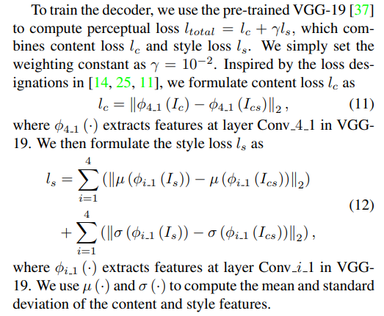
Decoder training
MSE loss on :
transformed image / content image
transformed image / style image
(in the feature space)

Slide 19
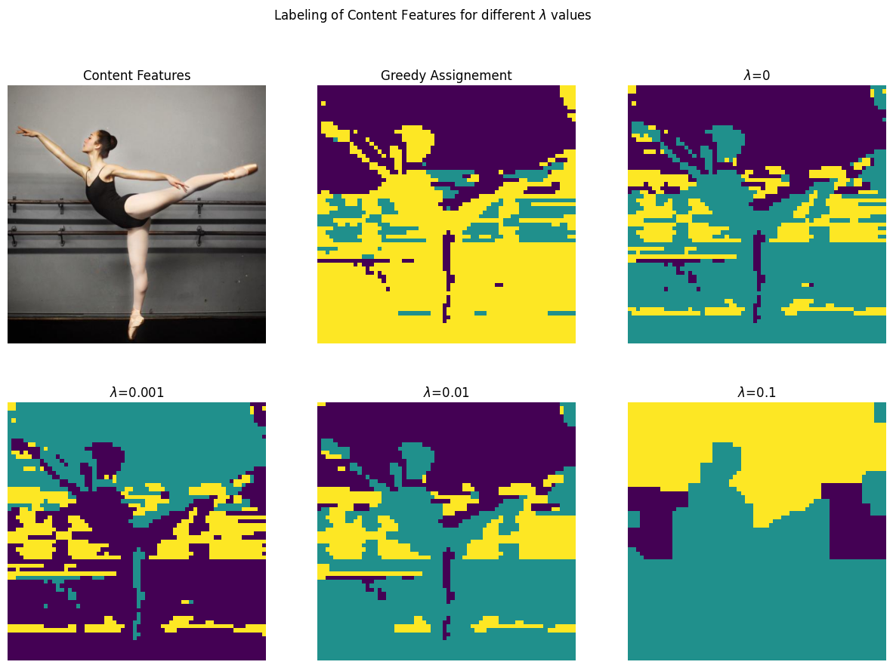

Slide 20
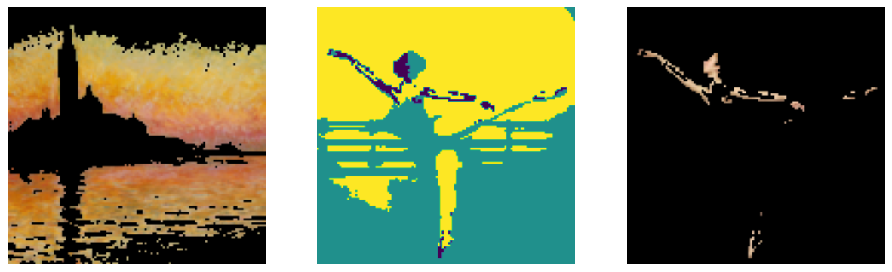
seeing the cluster match making
distance to chosen cluster

